Slide 1
Covina High School
UC/CSU Application Information Workshop

Slide 2
What you'll need when applying for college
Transcripts
You don't need to submit your transcripts to UC/CSU at this point, but you must refer to them as you fill out the application to ensure the information you enter is accurate.
Test scores
You’ll have to include your scores from the ACT Plus Writing or the SAT Reasoning Test.
If you're applying for fall, be sure to complete these tests by December.
All applicants should report scores for any SAT Subject Tests or Advanced Placement exams they have taken.

Slide 3
What you'll need when applying for college
Annual income for 2016
You’ll need to include the parents’ and student’s income (if applicable). This is optional unless you're applying for an application fee waiver or for the Educational Opportunity Program.
Social Security number, if you have one
This is used to match your application to your test score report, final transcript, and your Free Application for Federal Student Aid.

Slide 4
What you'll need when applying for college
California Statewide Student ID
Each K-12 student in California public schools is assigned an ID number. It is printed on the bottom left of the transcript.
Credit Card
If you prefer to pay by check, you can mail your payment.

Slide 5
The CSU Application

Slide 6
CSU Campuses that are not impacted for freshmen 2019
Bakersfield
Channel Islands
Dominguez Hills
East Bay
Maritime Academy
San Francisco
Stanislaus

Slide 7
CSU Application www.calstate.edu/apply

Slide 8
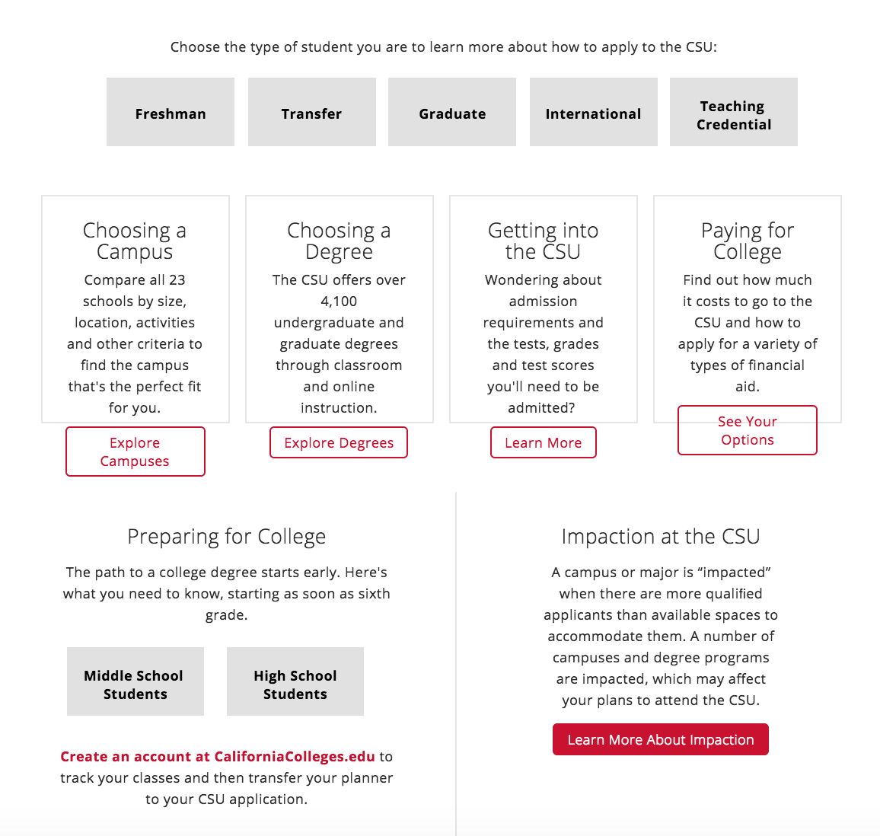

Slide 9
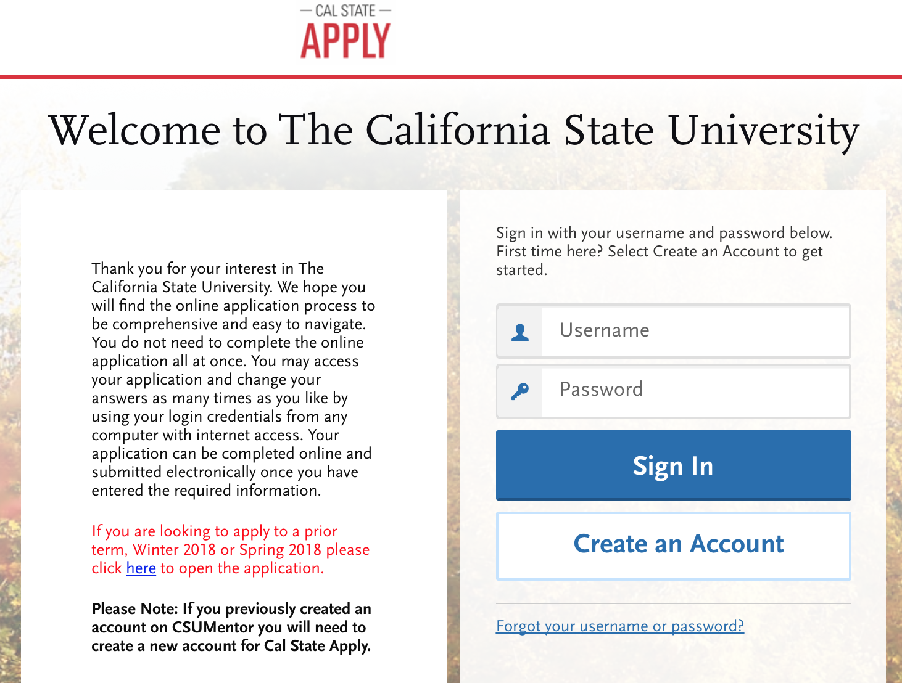

Slide 10
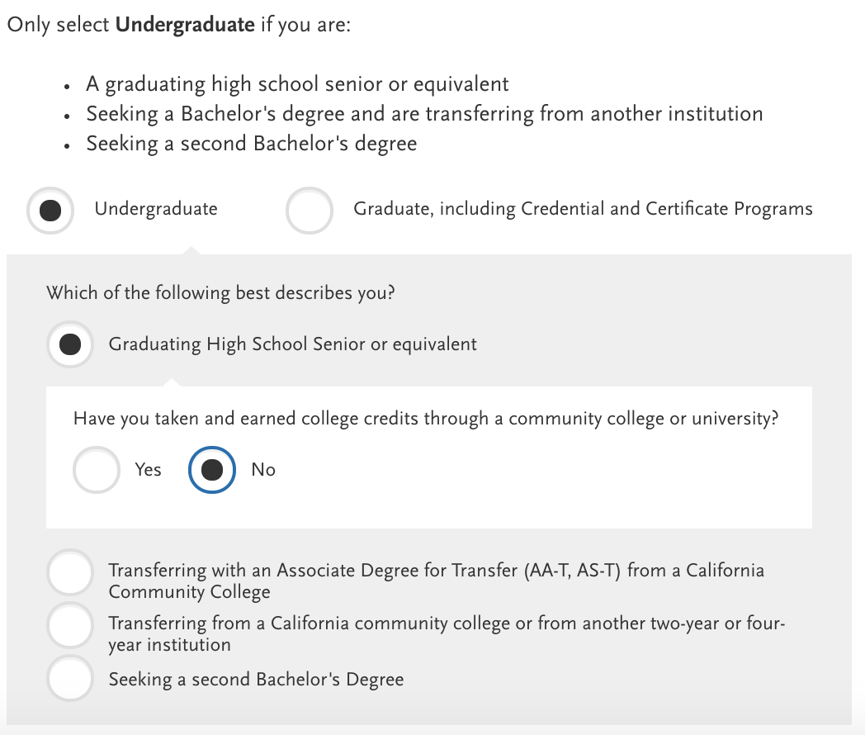
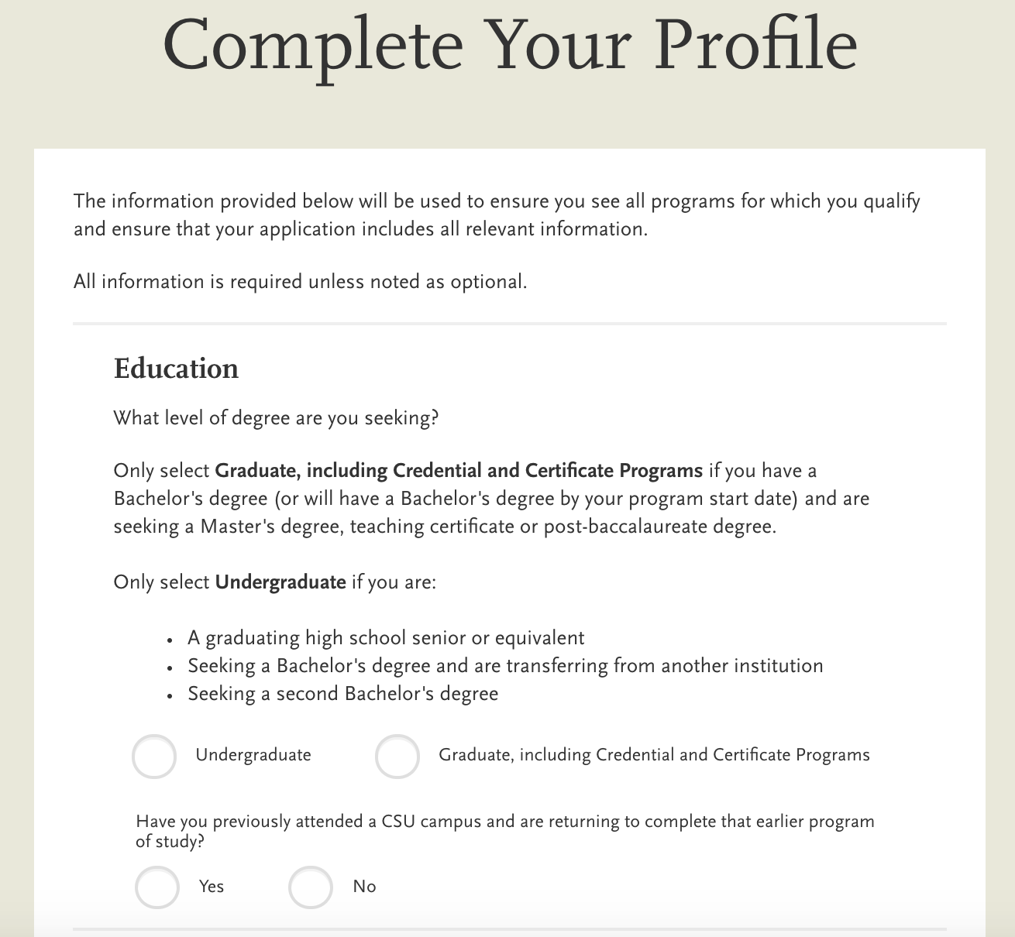
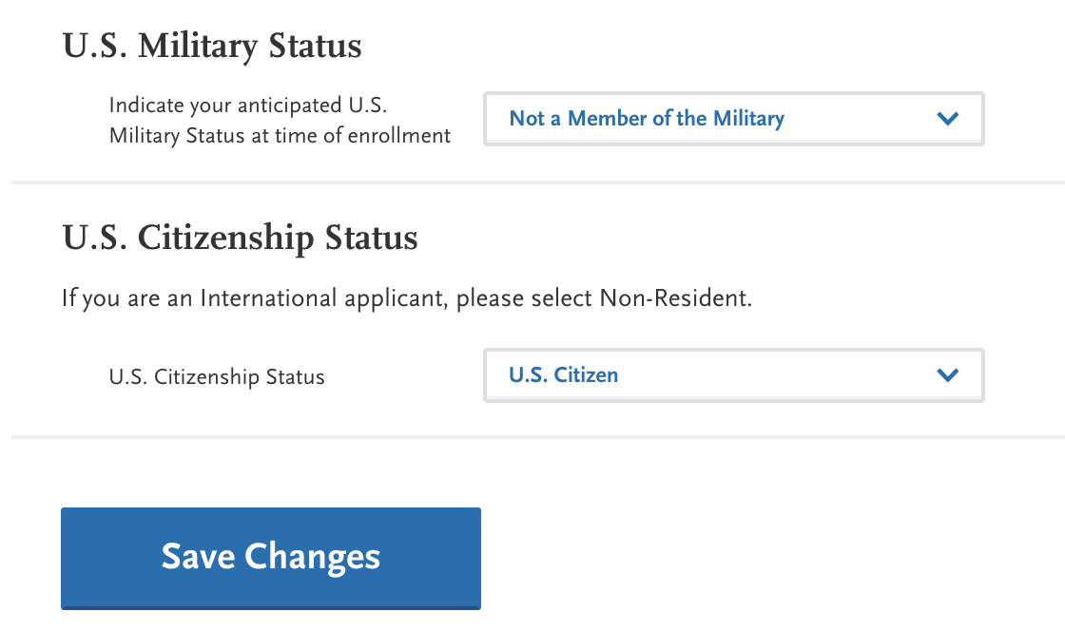
Complete Your Profile

Slide 11
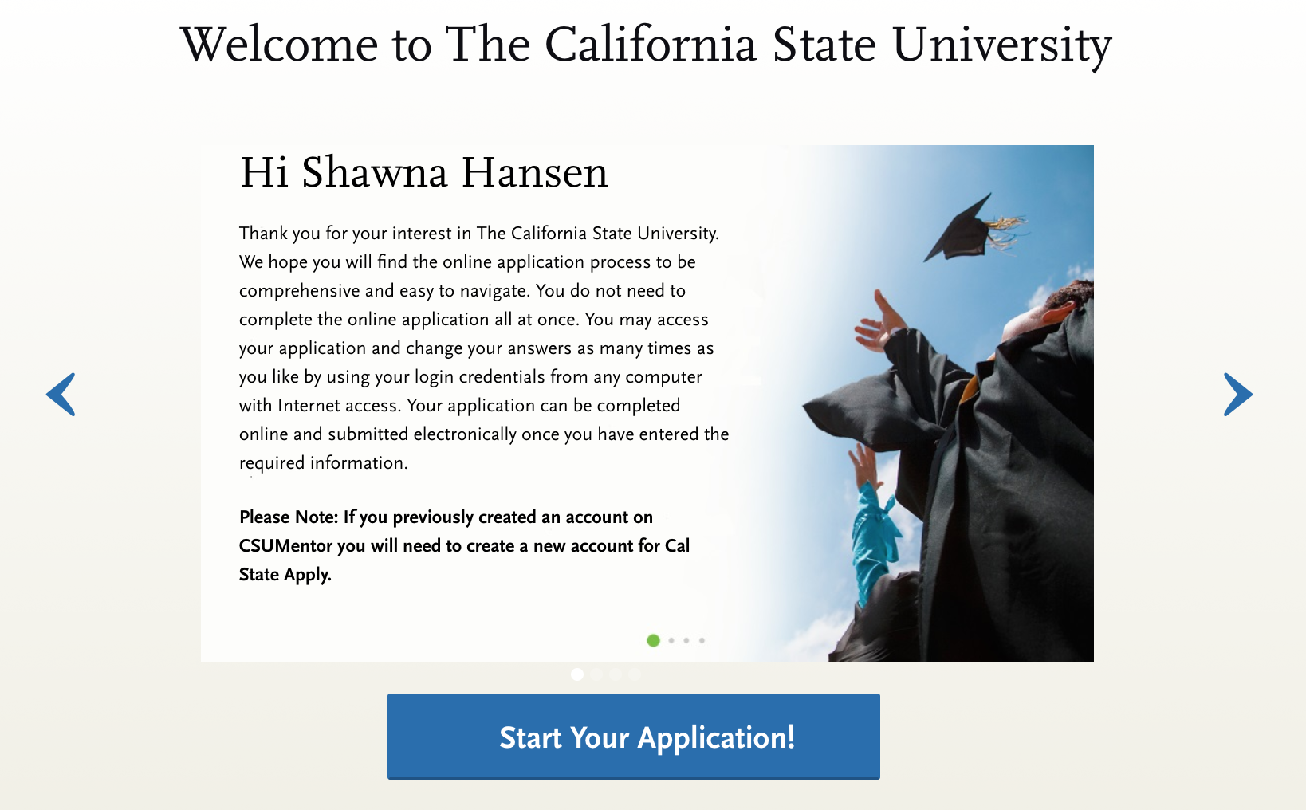
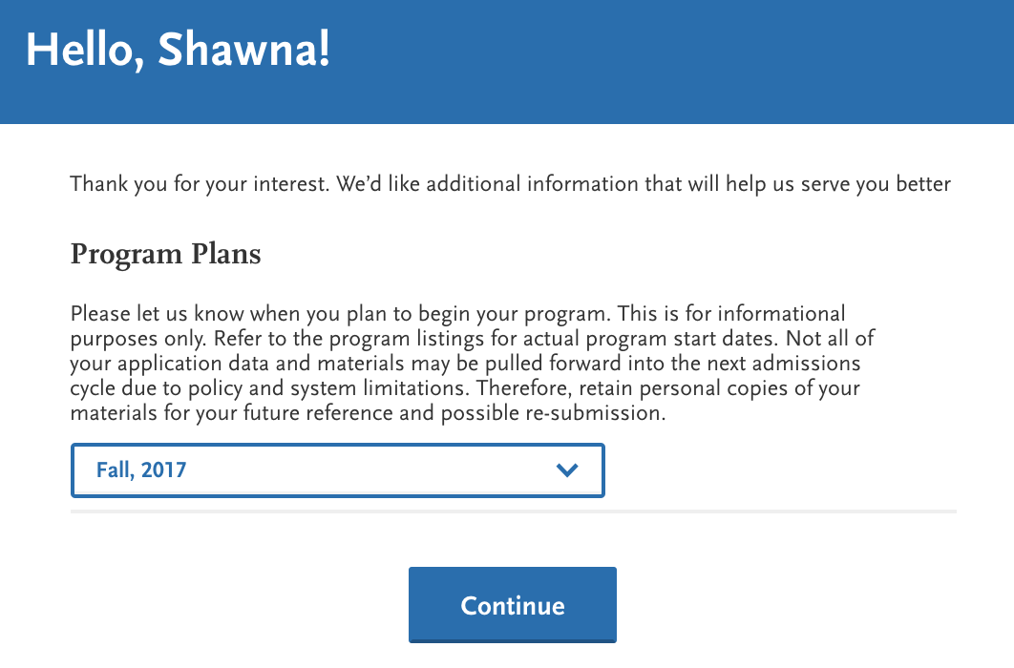
PLEASE SELECT:
FALL 2018

Slide 12
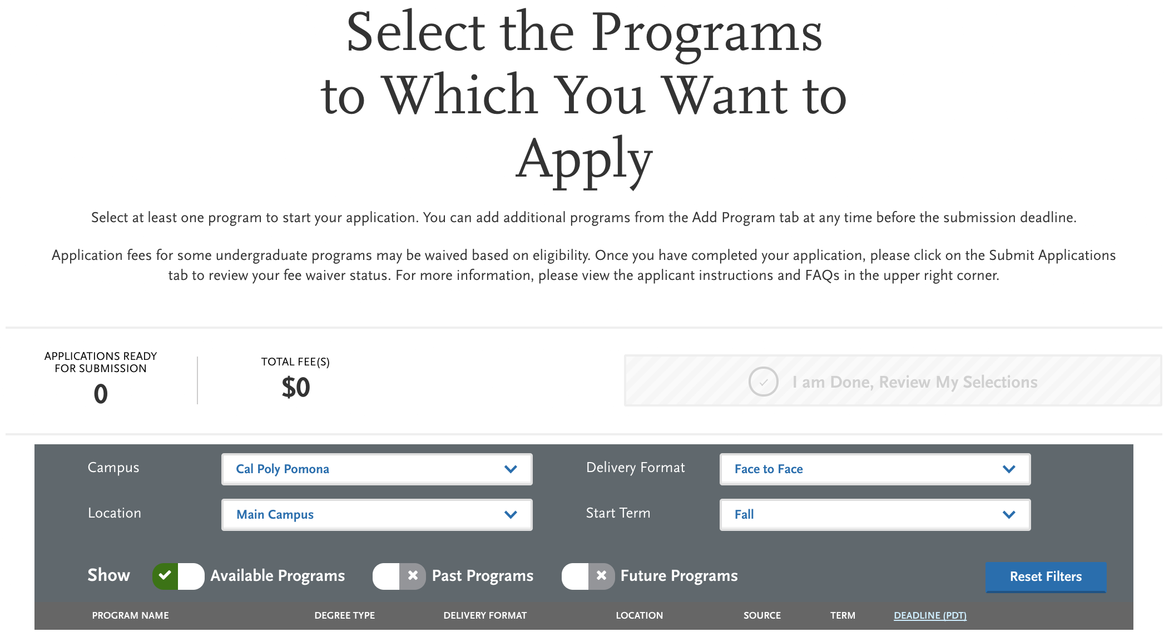
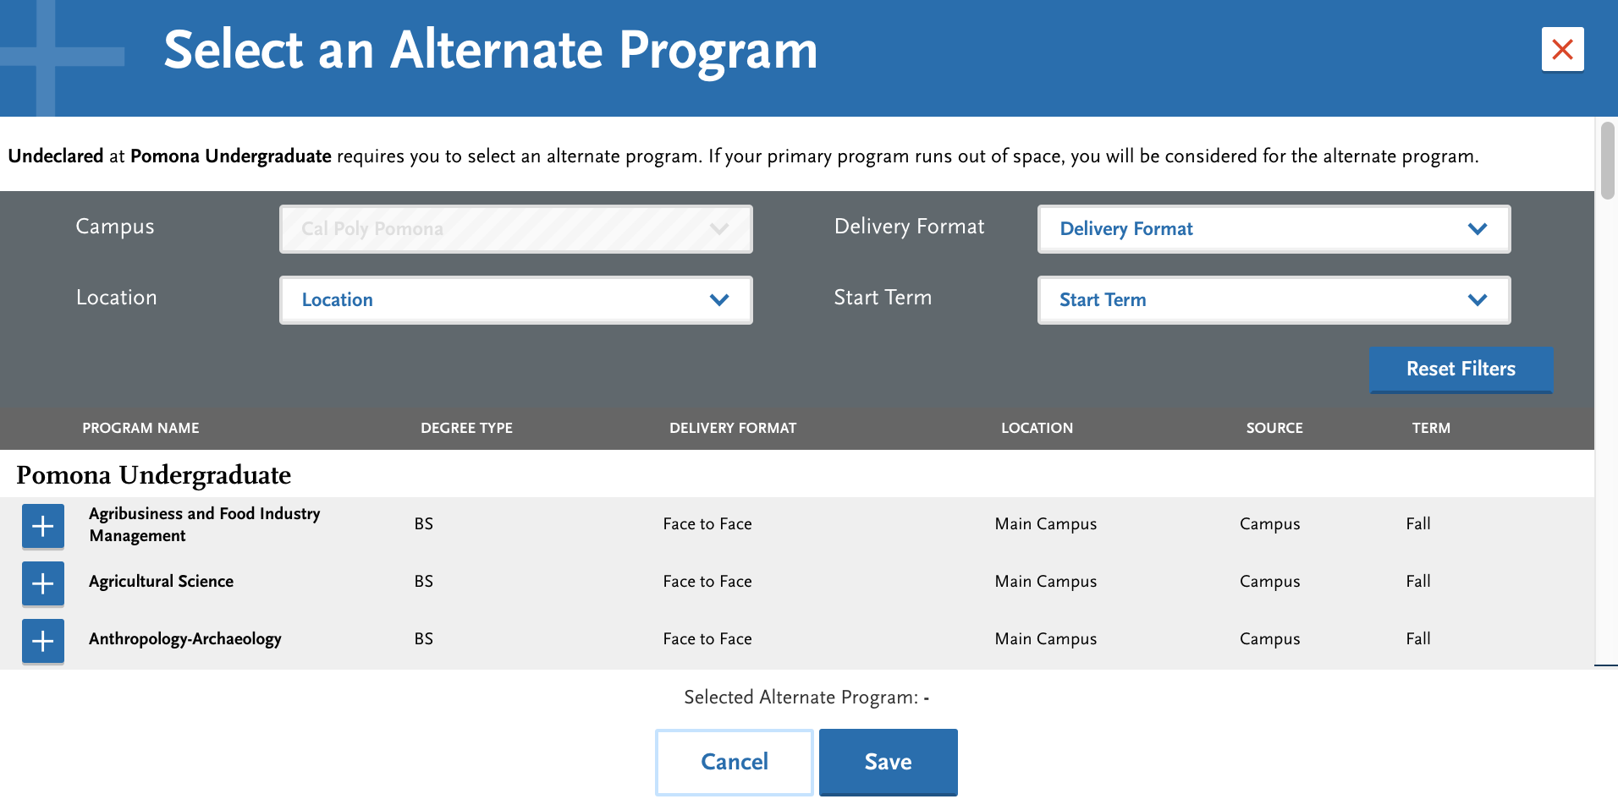
Select Your Campus and Program

Slide 13
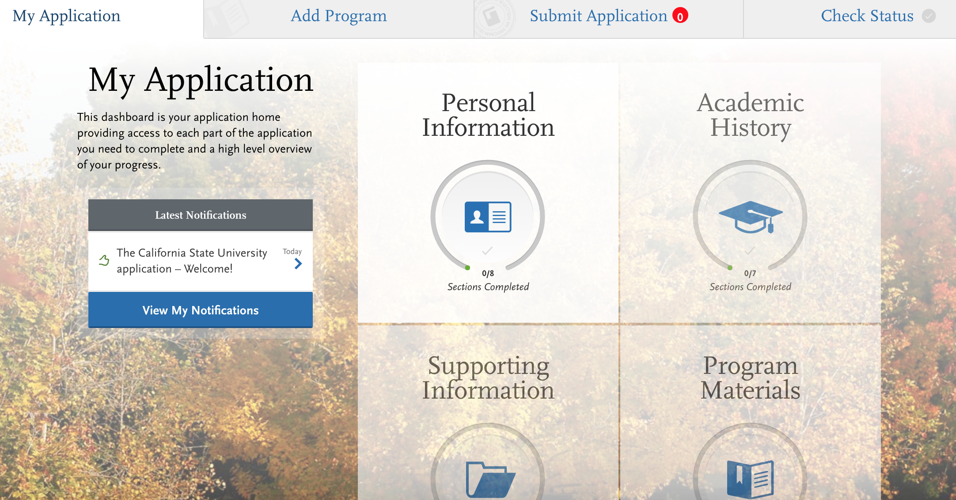
Application Dashboard

Slide 14
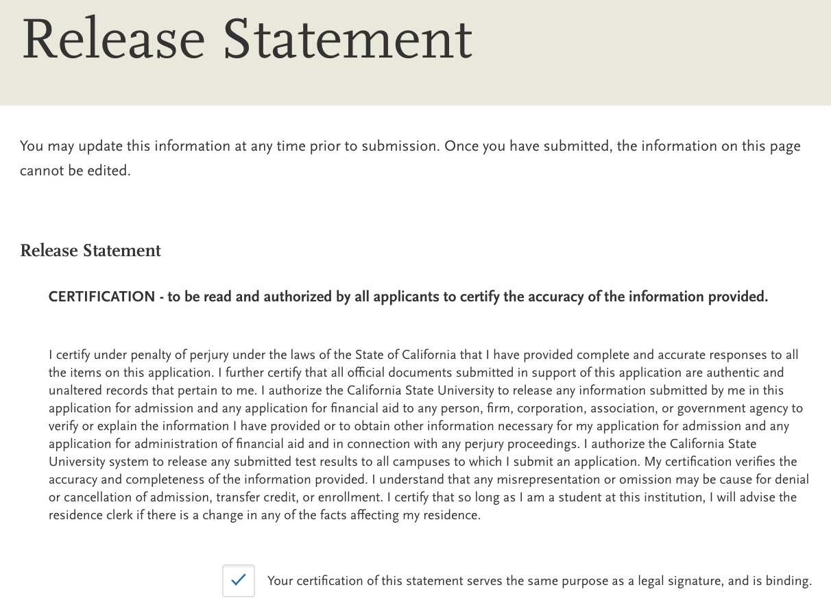
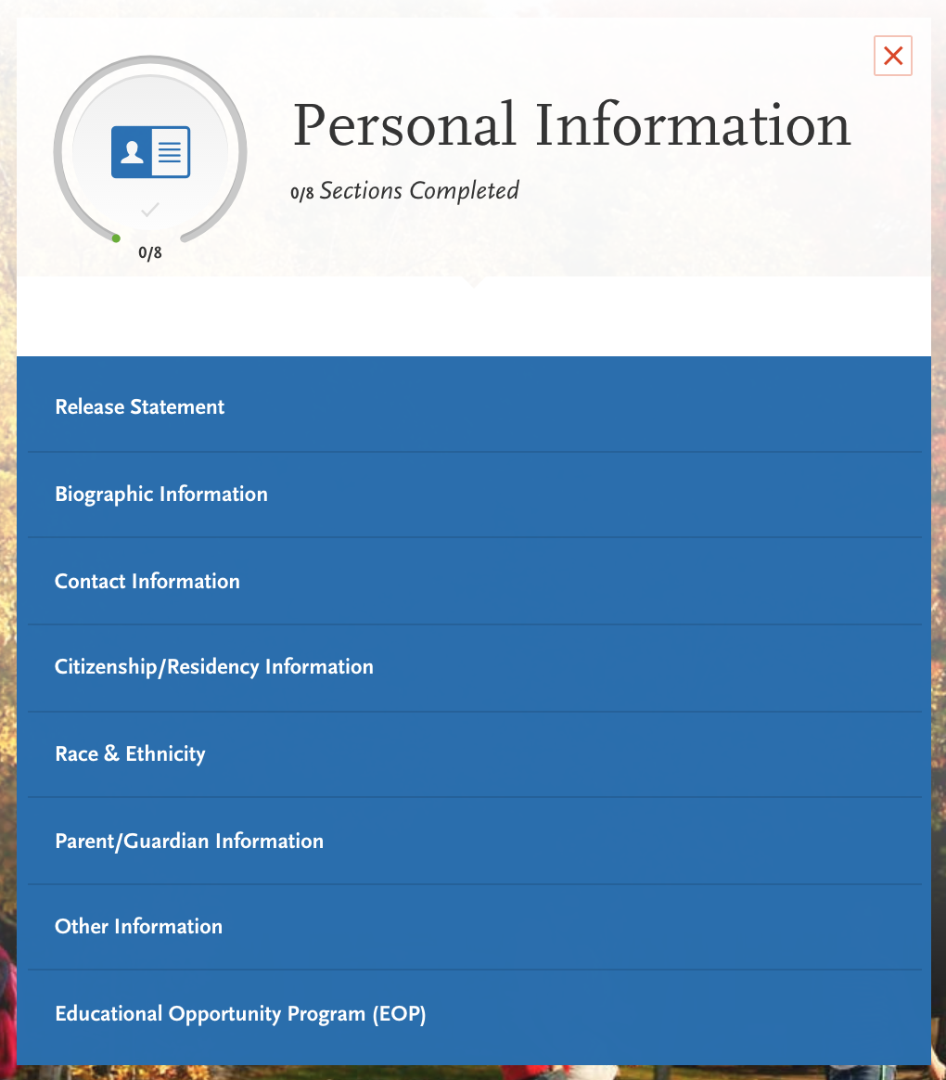
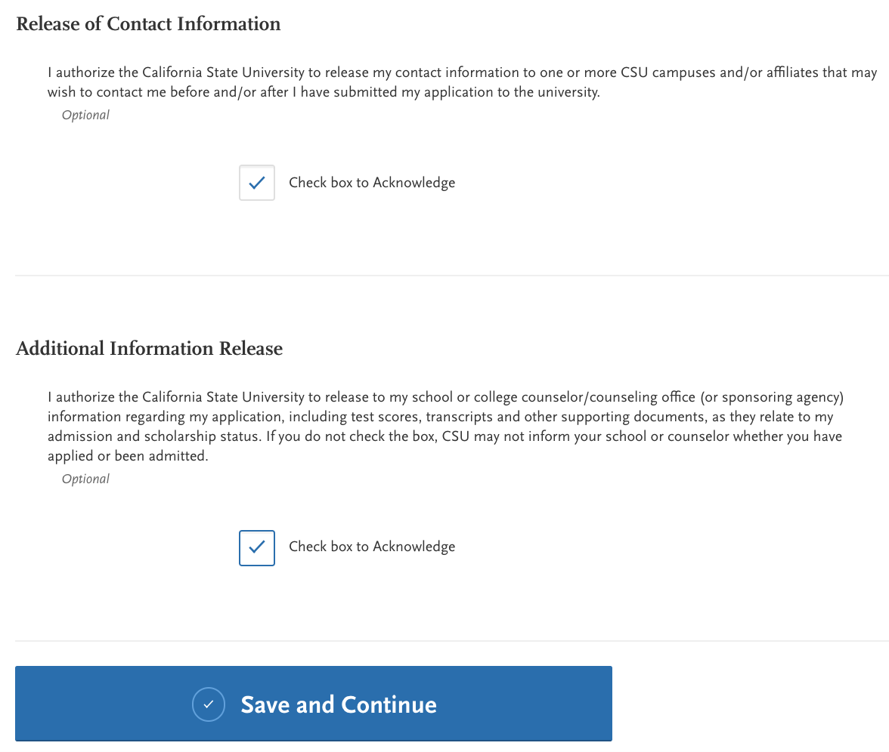
Personal Information

Slide 15
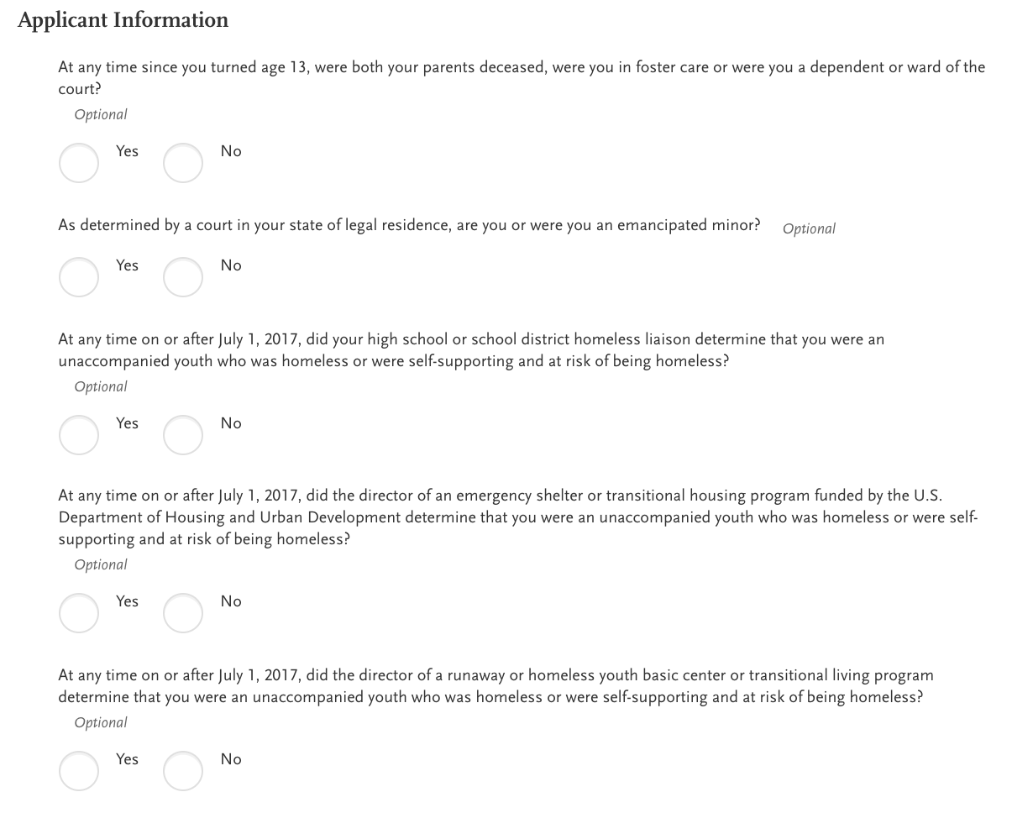
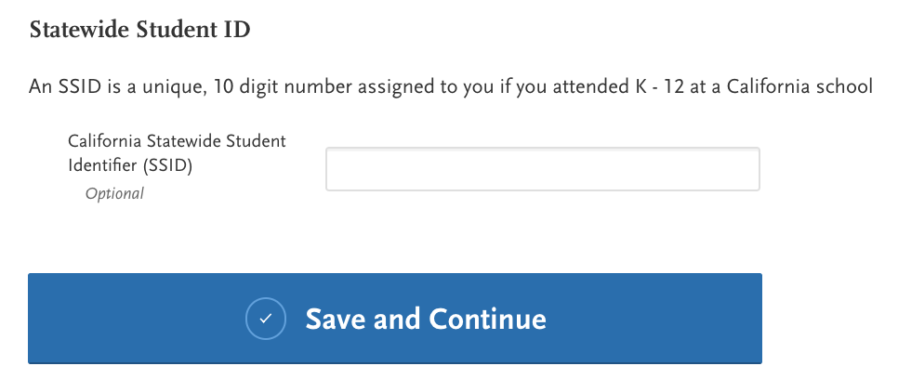
SSID is listed at the bottom of your transcript

Slide 16
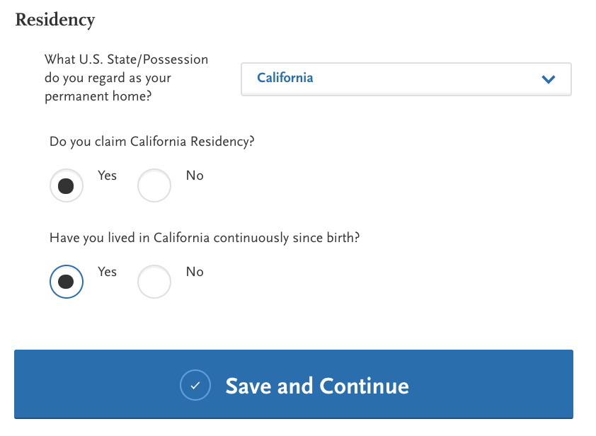
*You must check yes if you want the school to be able to talk at your parents about the application.
*Enter your correct SSN, if you have one.
Do not guess…it is important you enter the correct number!

Slide 17
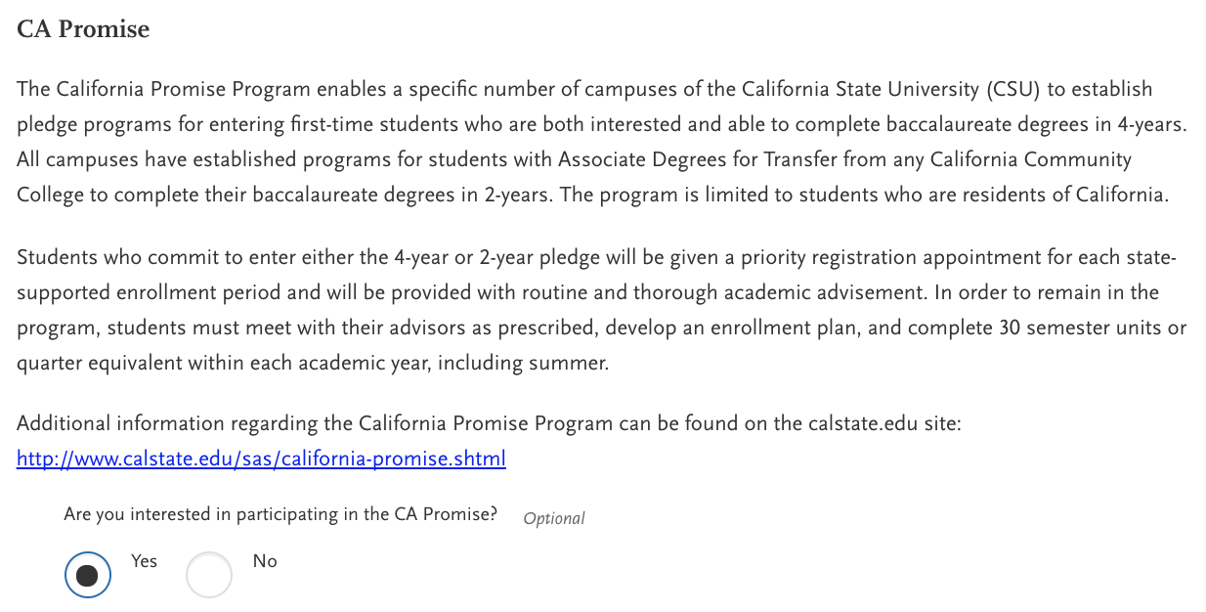

Slide 18
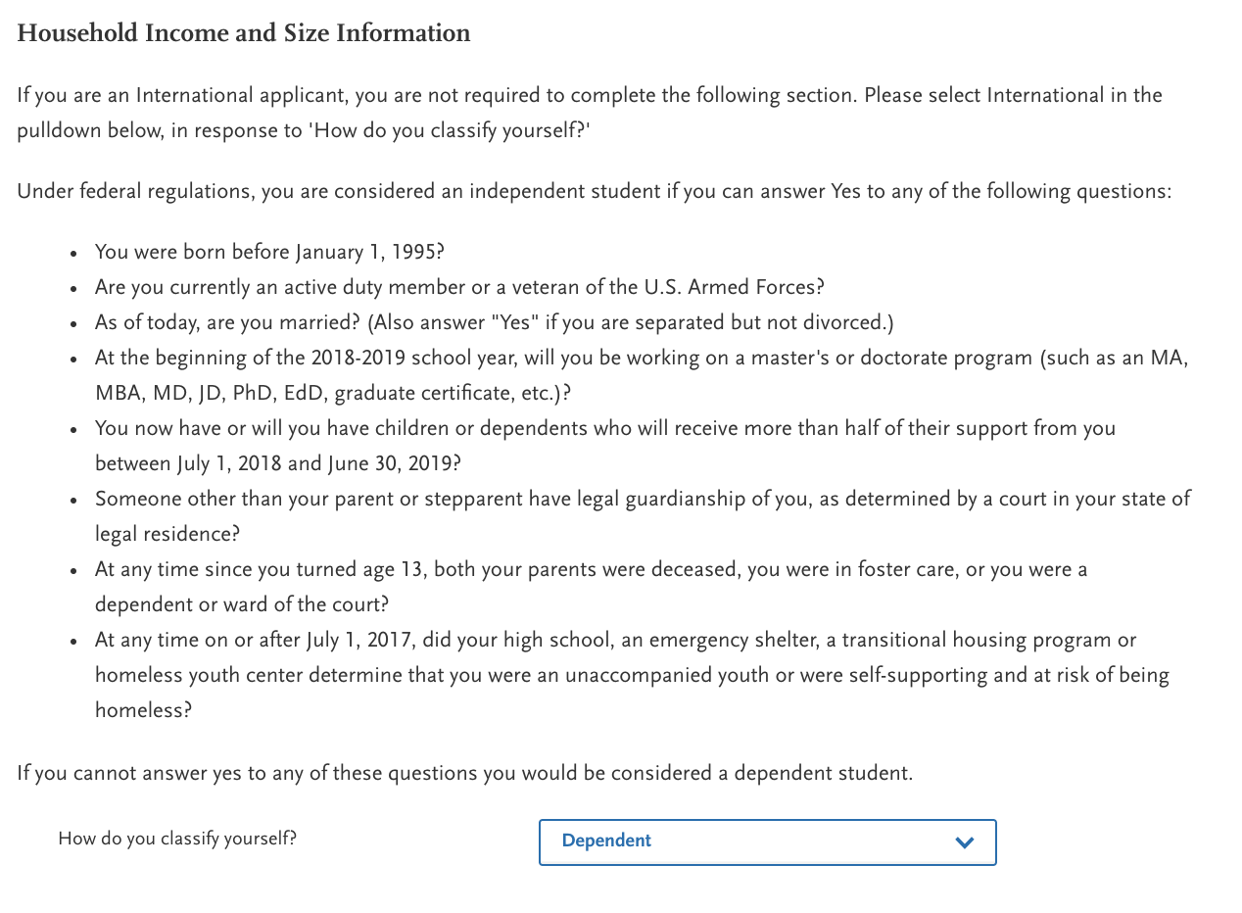
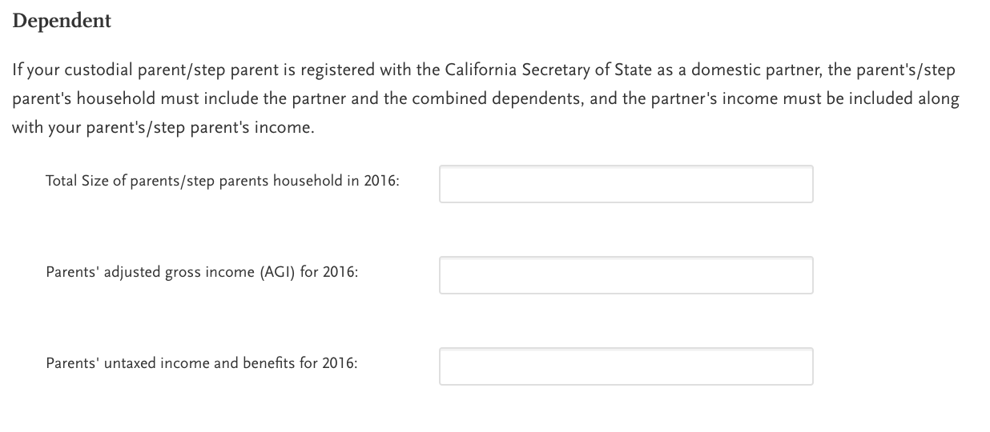
You are a Dependent Student

Slide 19
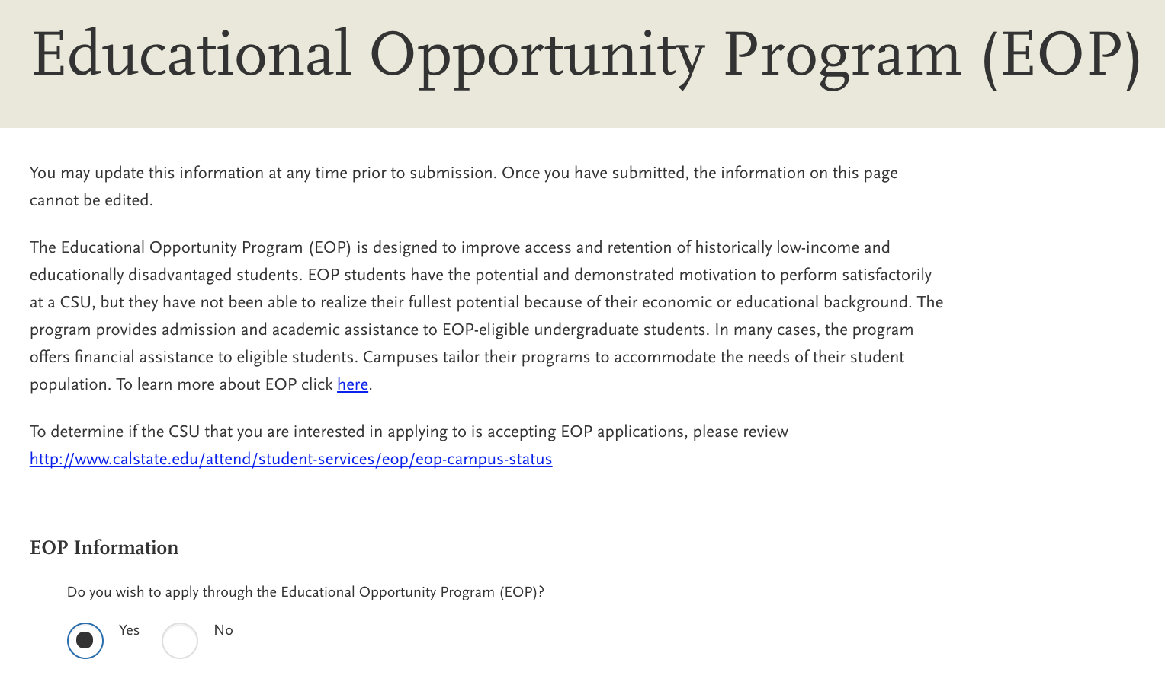
Educational Opportunities Program (EOP)

Slide 20
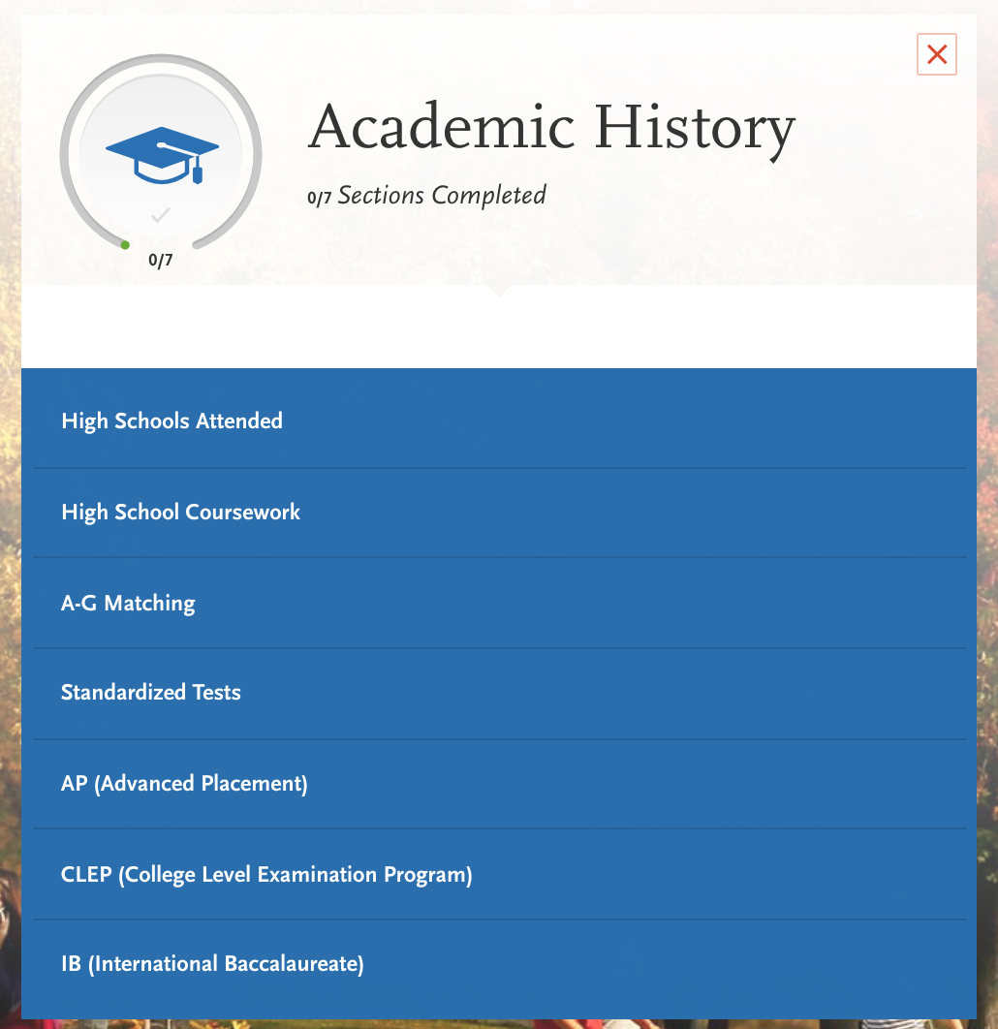
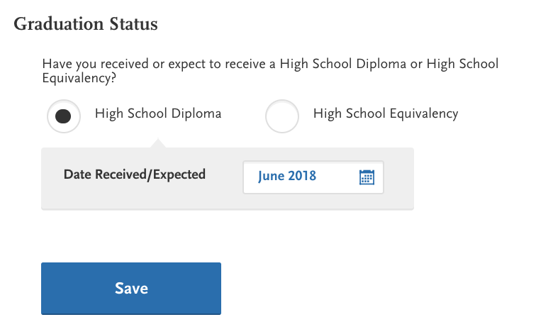
Academic History
Graduation Date:
June 2018

Slide 21
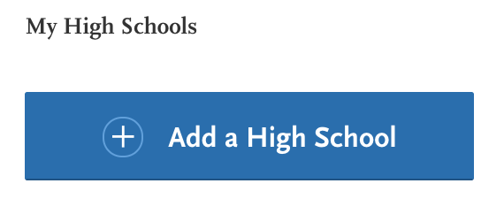
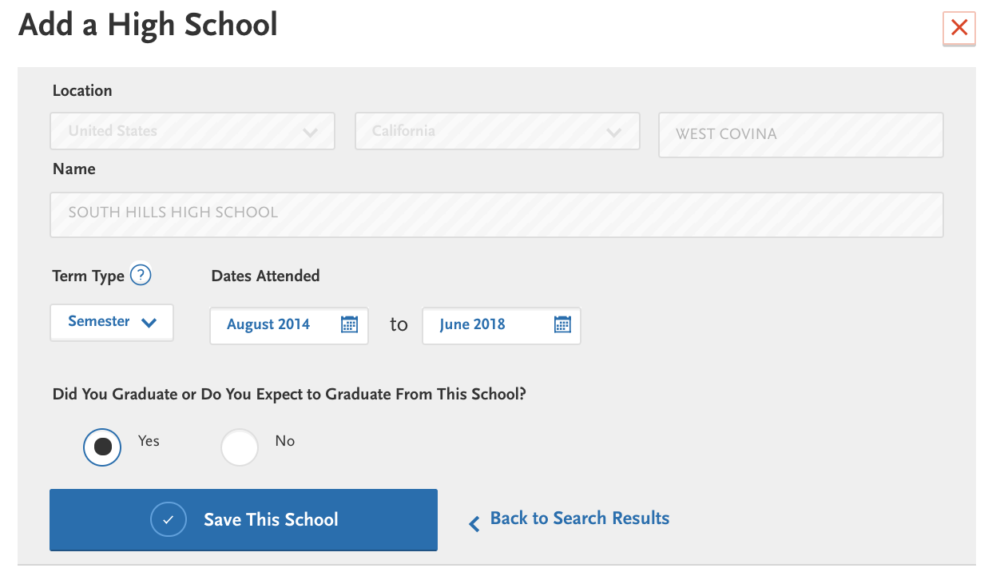
COVINA HIGH SCHOOL

Slide 22
COVINA HIGH SCHOOL
COVINA HIGH SCHOOL

Slide 23
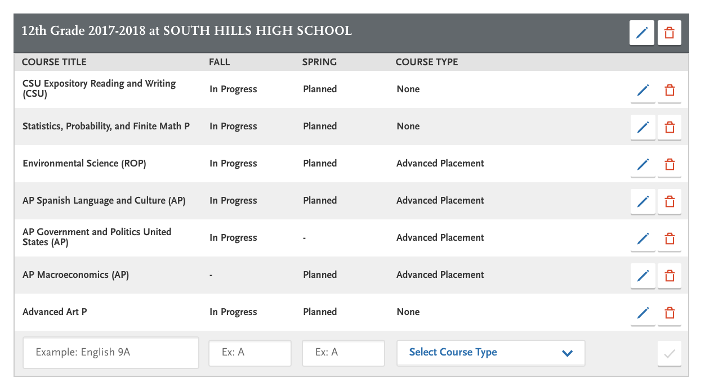
For 12th Grade Courses, 1st Semester (Fall) should be “In Progress” and
2nd Semester (Spring) should be “Planned”
Don’t forget about any classes you are taking in Credit Recovery.

Slide 24
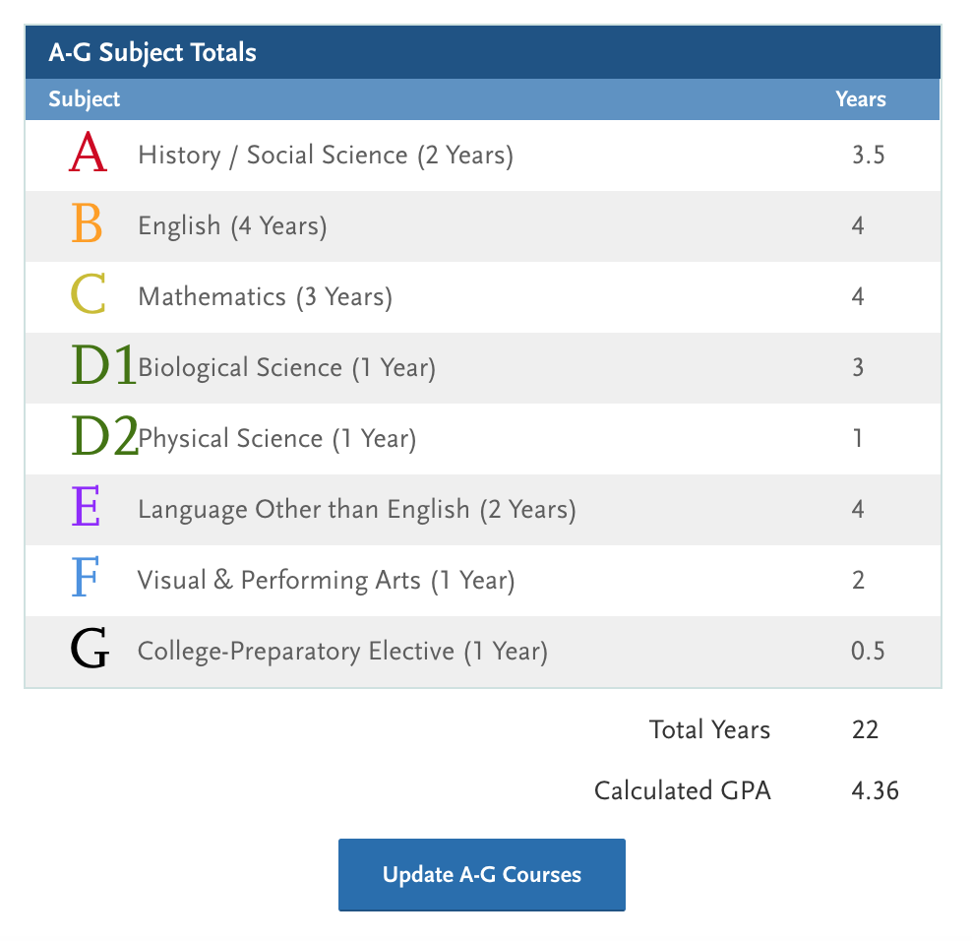
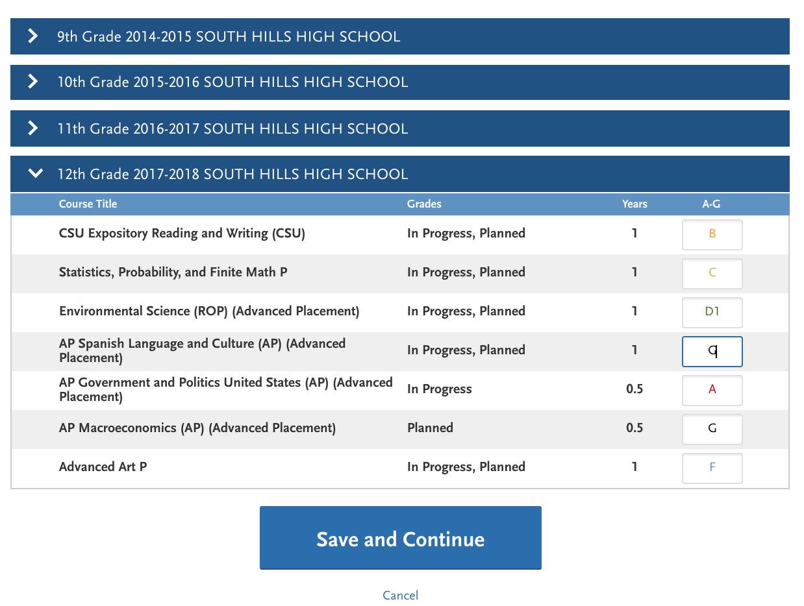
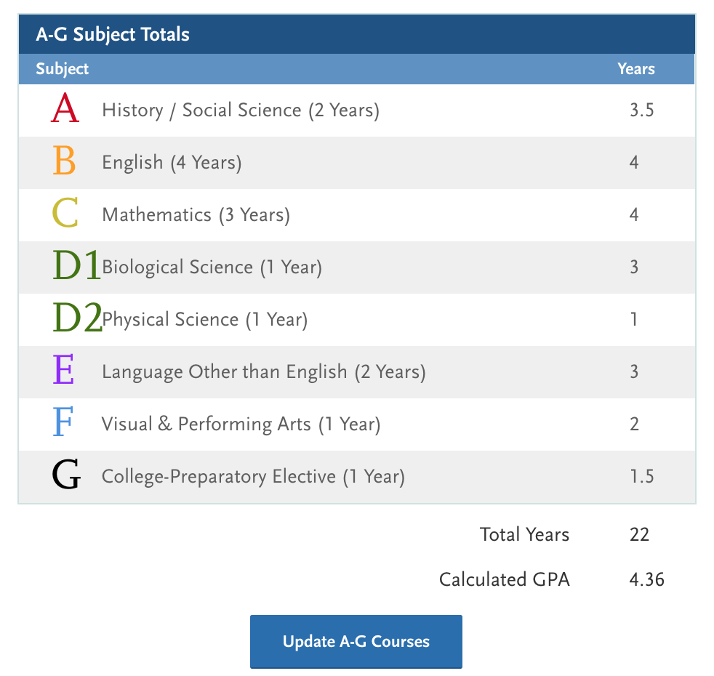

Slide 25
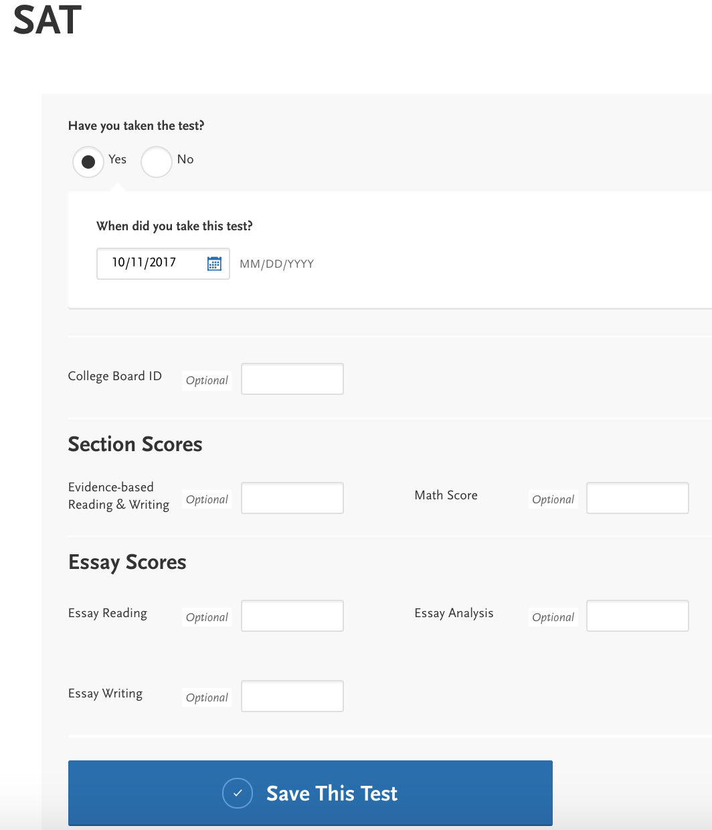
Test Scores
Enter:
SAT/ACT scores
Date of test taken OR planned date to take the test

Slide 26
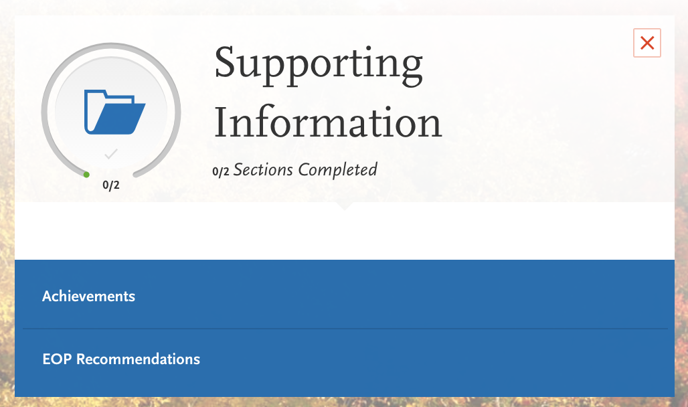
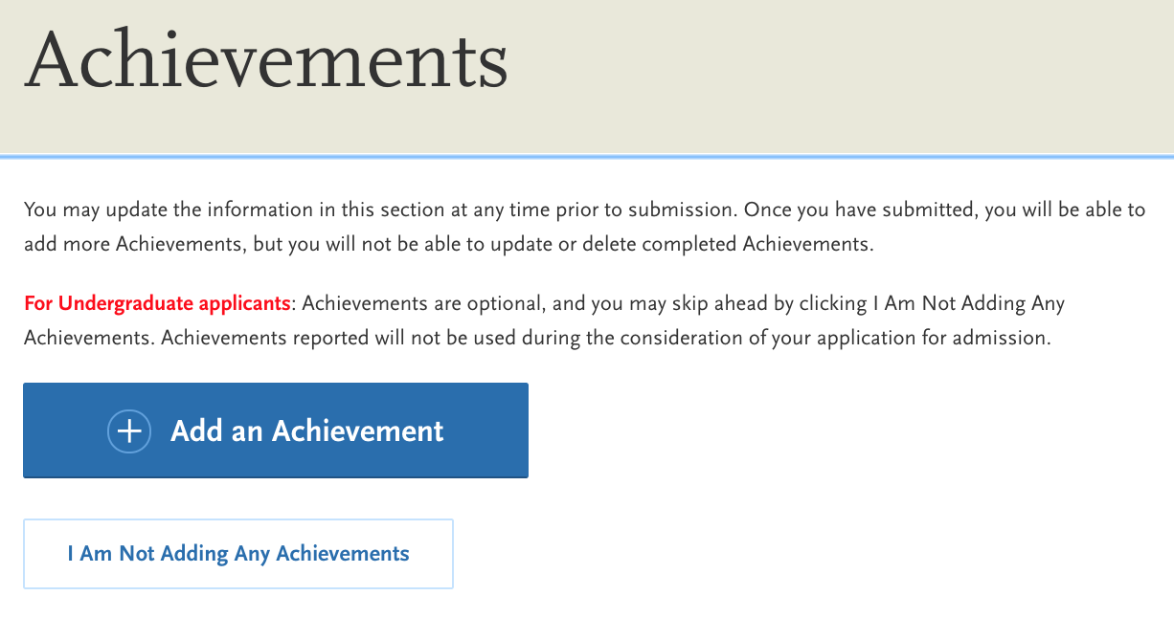
Supporting Information

Slide 27
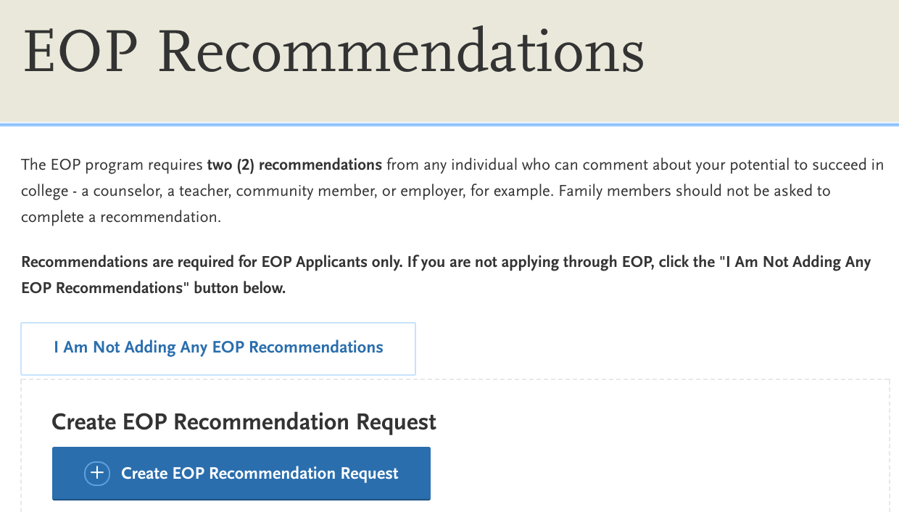
EOP Recommendations

Slide 28
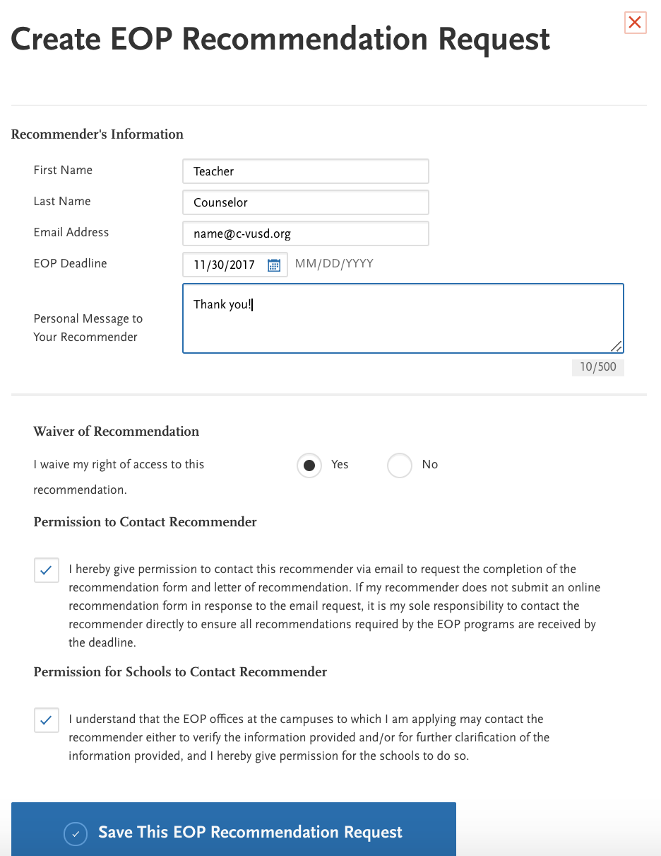

Slide 29
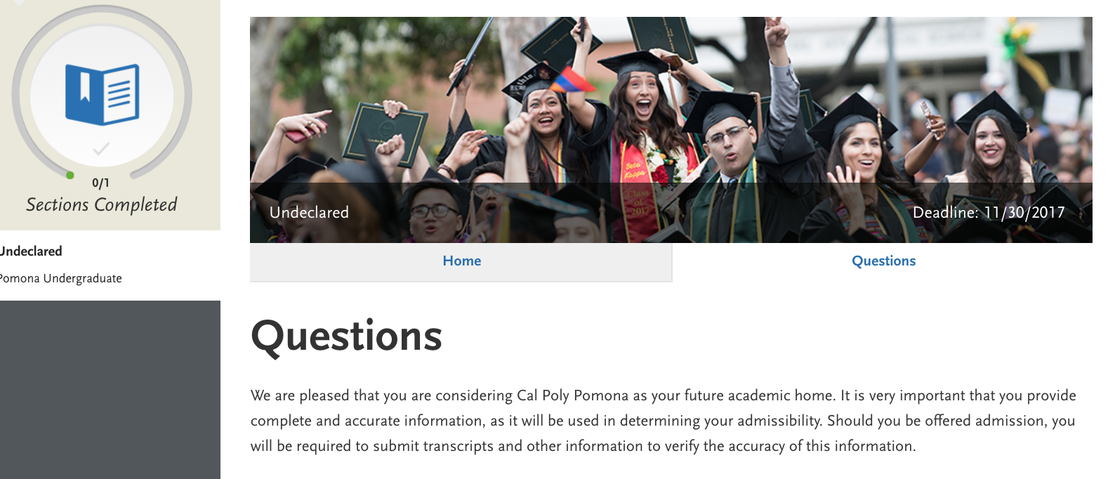
Program Materials

Slide 30
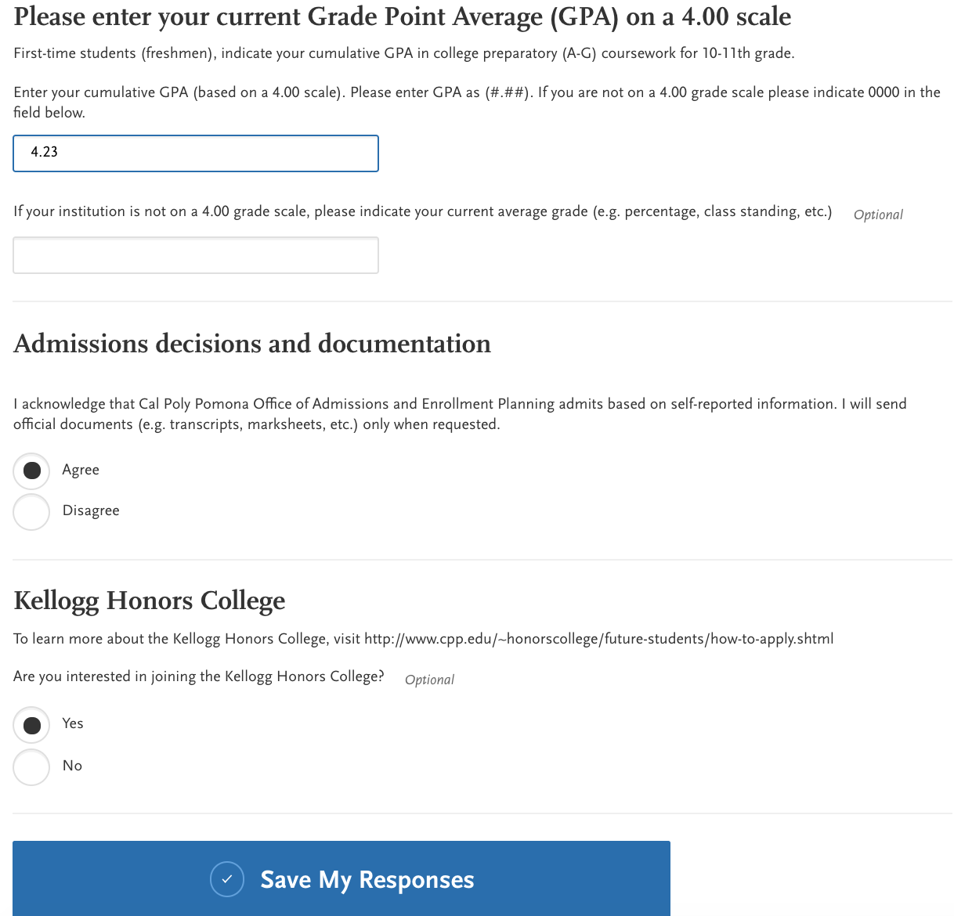
3.92

Slide 31
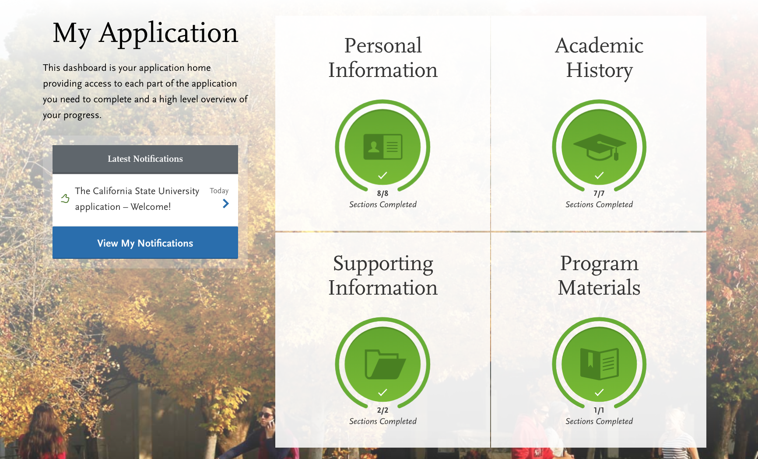
Review Your Application

Slide 32
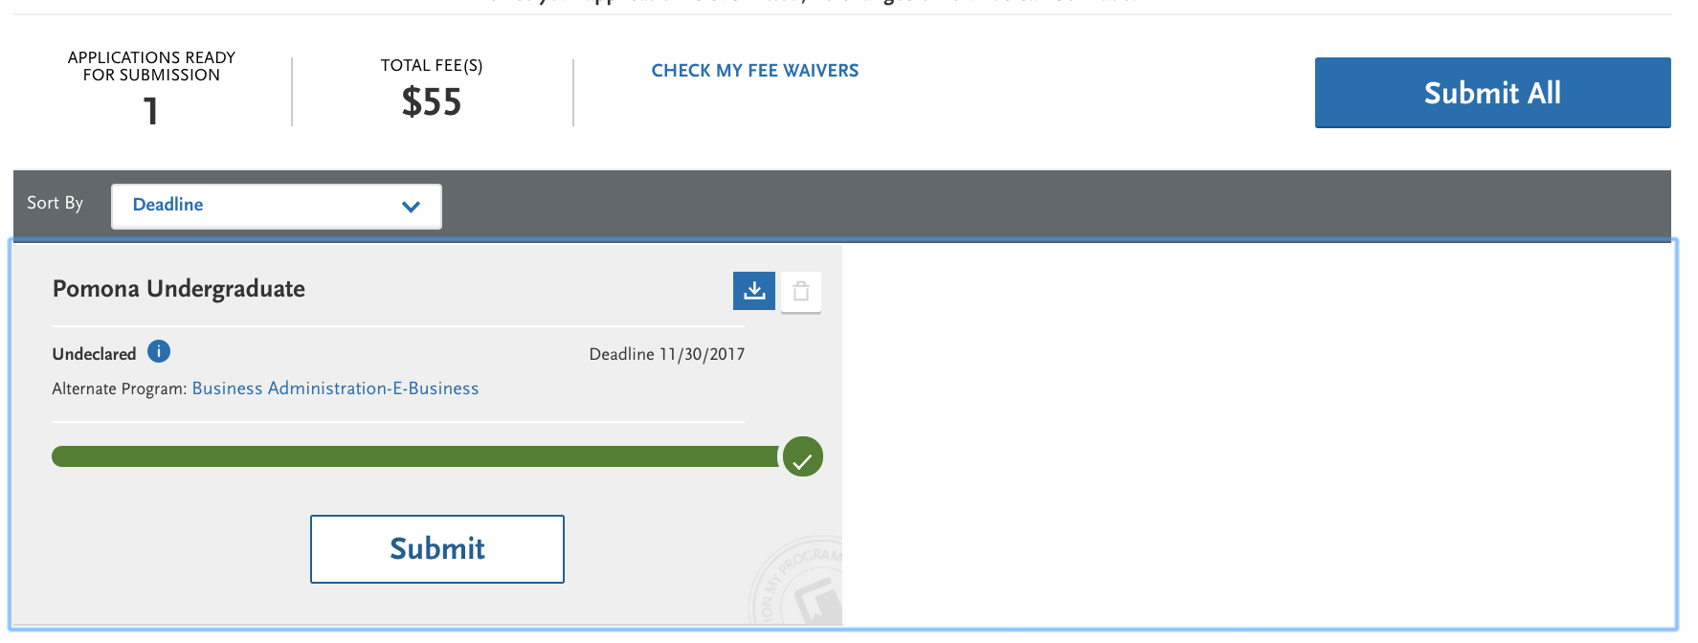
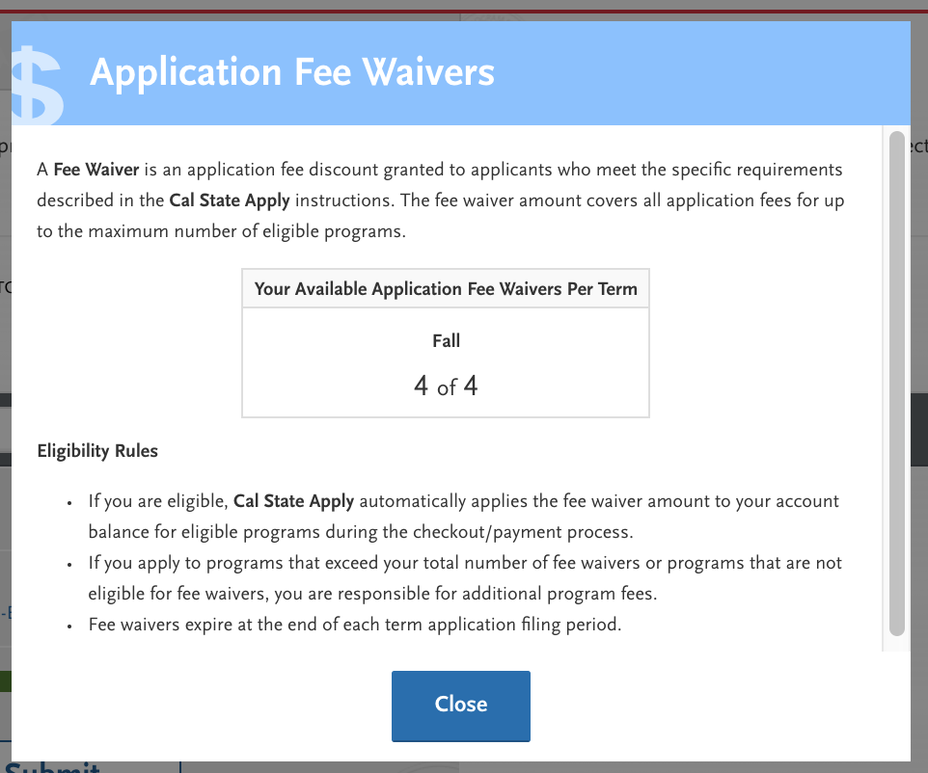

Slide 33
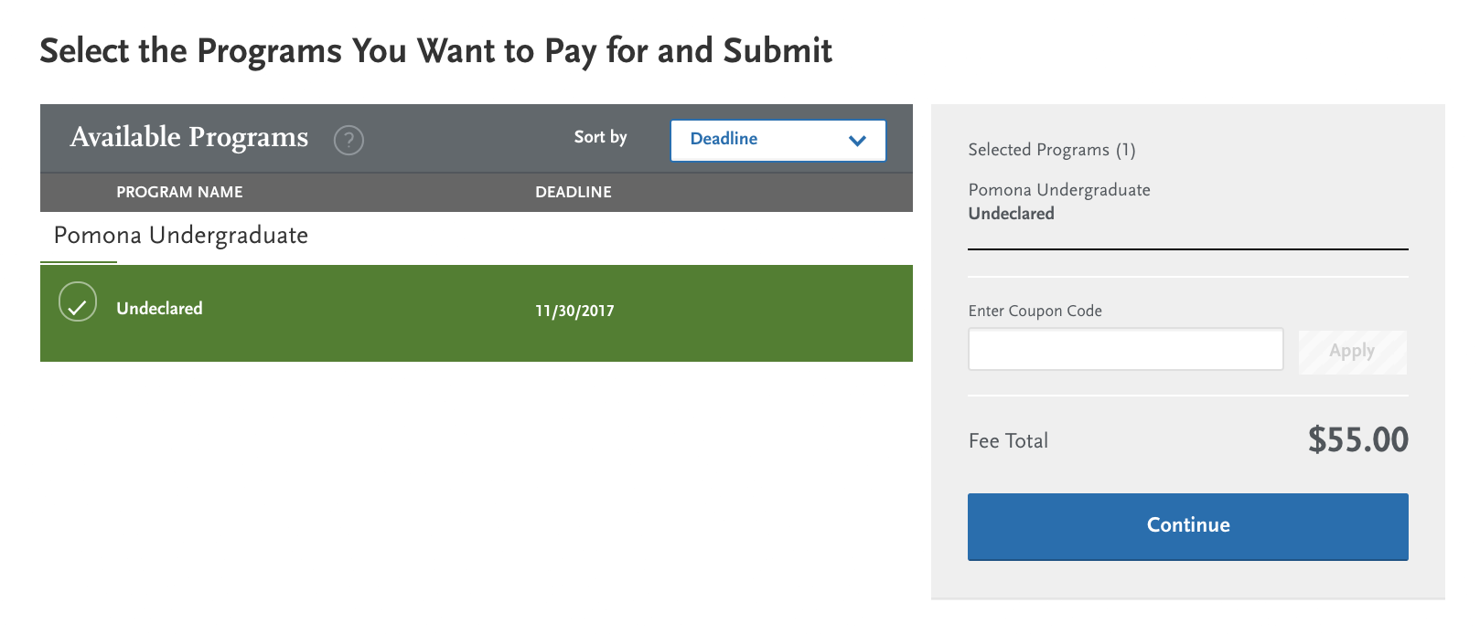
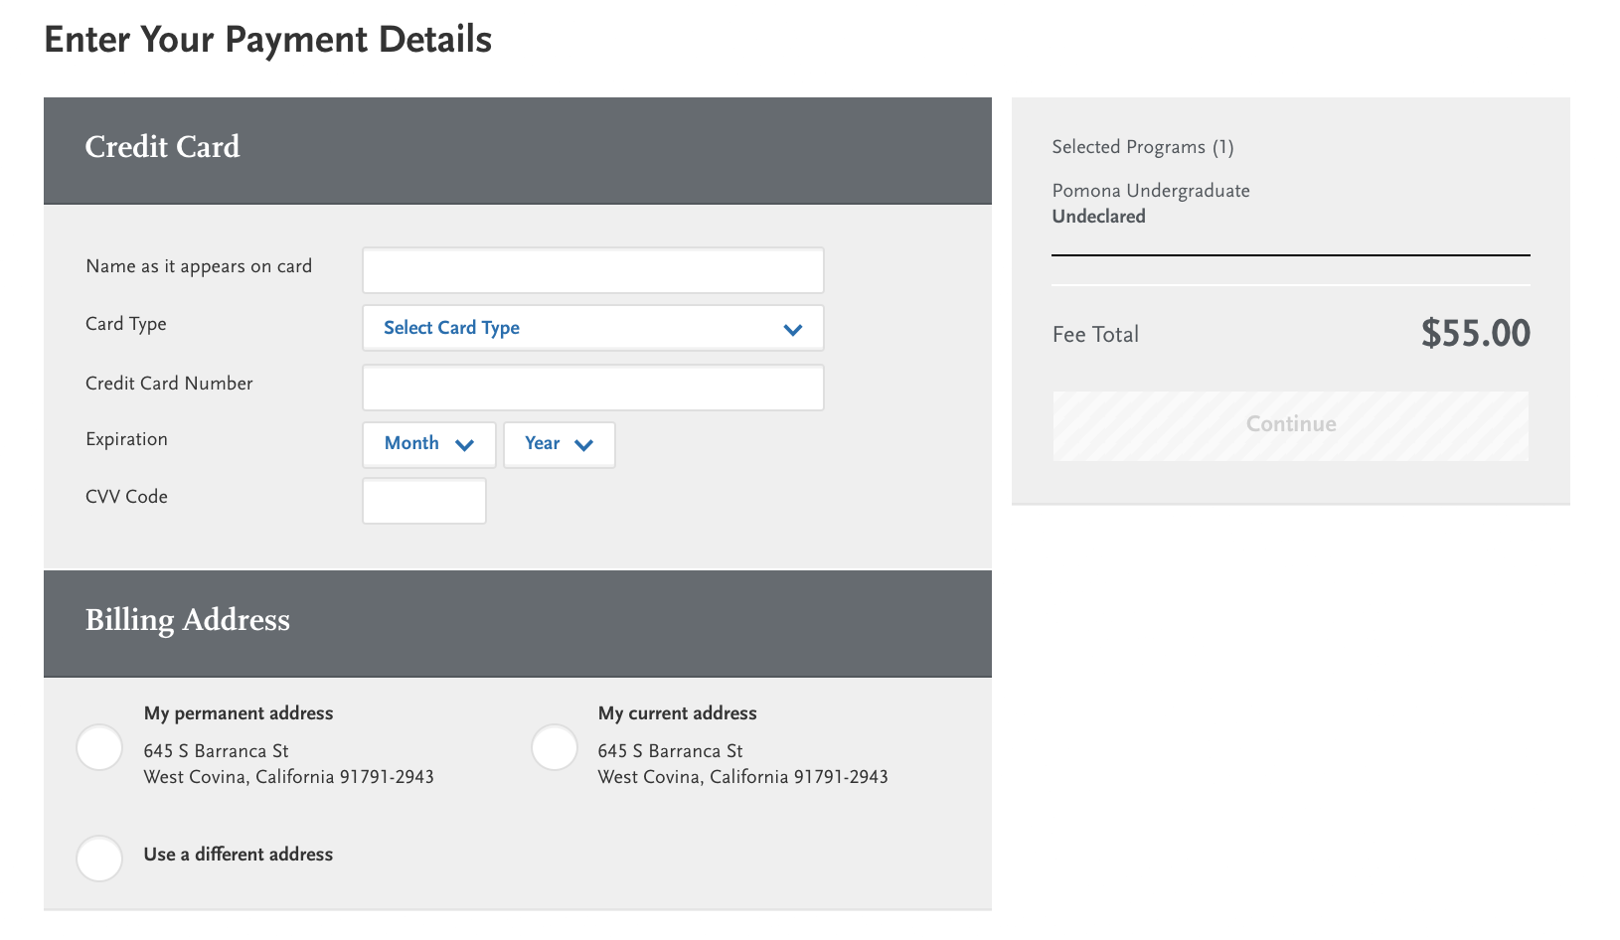

Slide 34
The UC Application

Slide 35
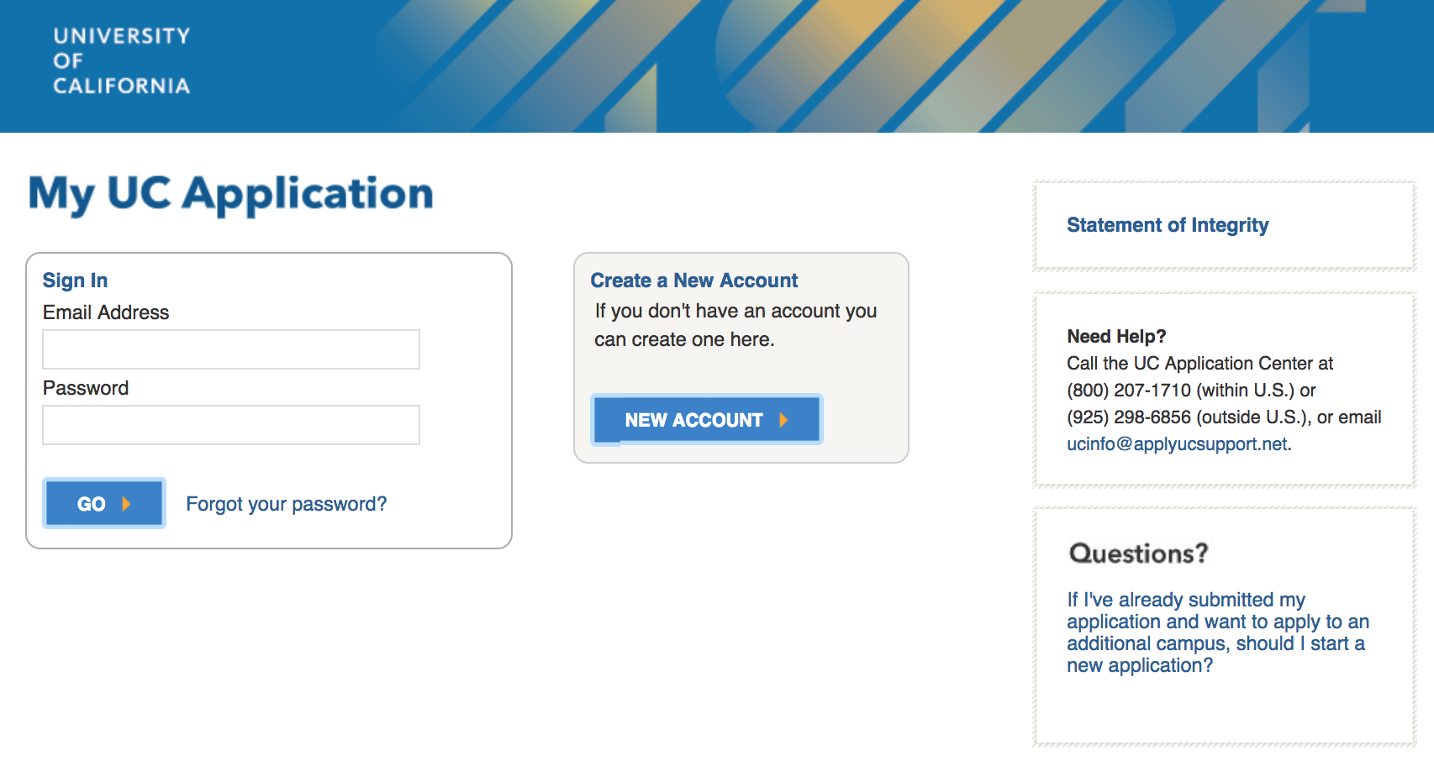
The UC Application www.admissions.universityofcalifornia.edu

Slide 36
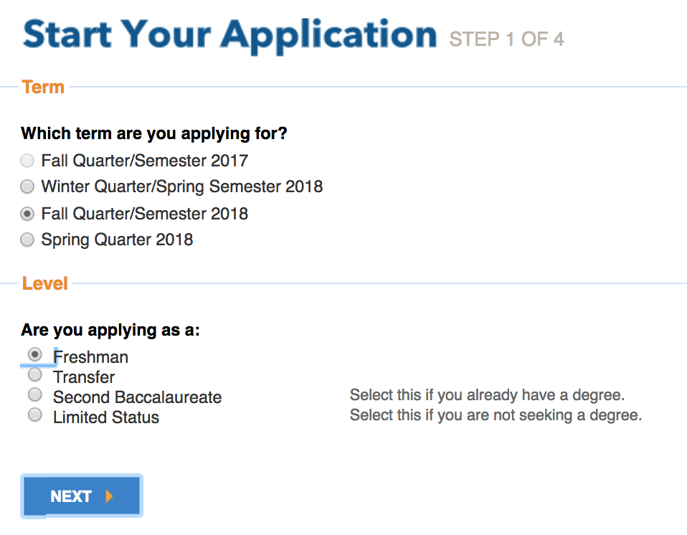
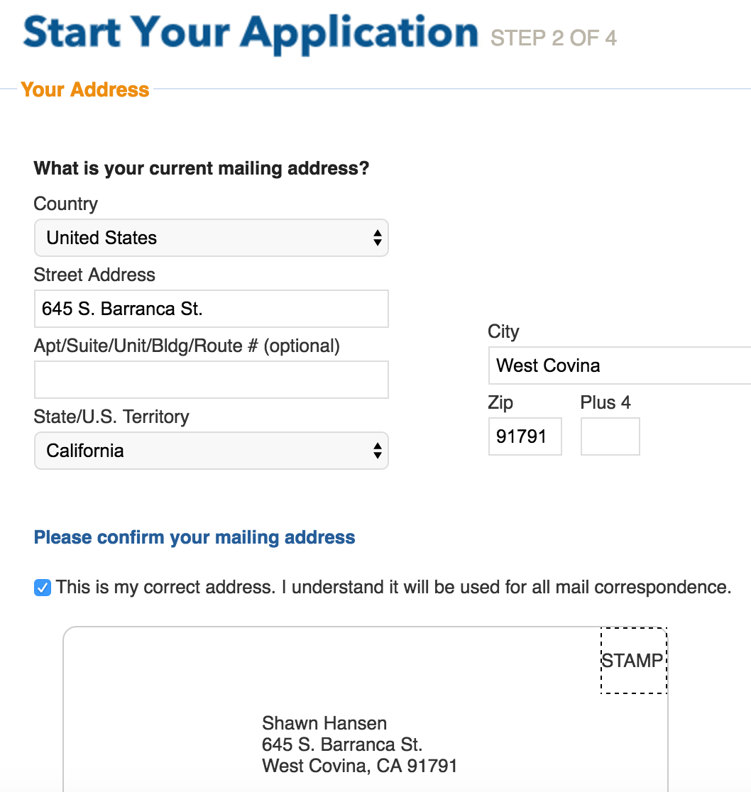
Start Your Application
Step 1: Apply for Fall Quarter/Semester 2018.
You are applying as a Freshman
Step 2: Type in your address and verify the envelope. If you use a cell phone number, UC will send updates and other announcement via text message.

Slide 37
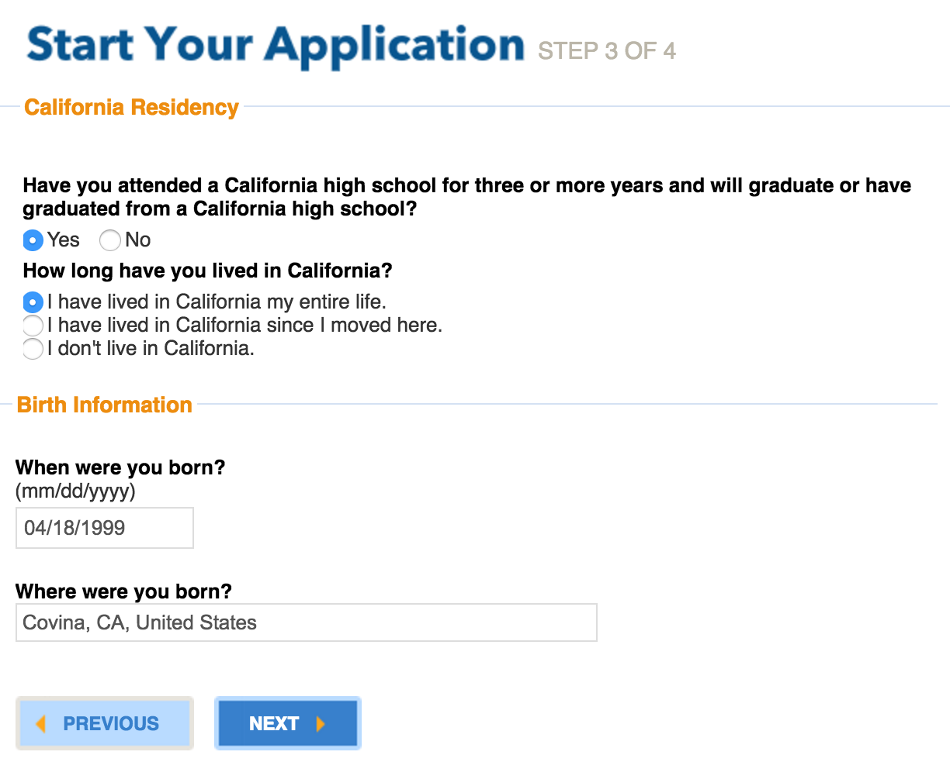
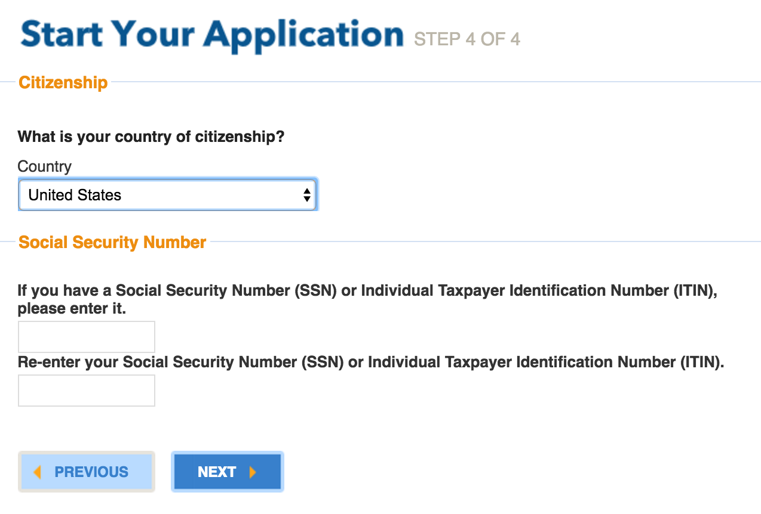
Step 3: You are a California resident if you have attended a California high school for 3 or more years.
Step 4: Enter your correct SSN, if you have one.
Do not guess…it is important you enter the correct number!

Slide 38
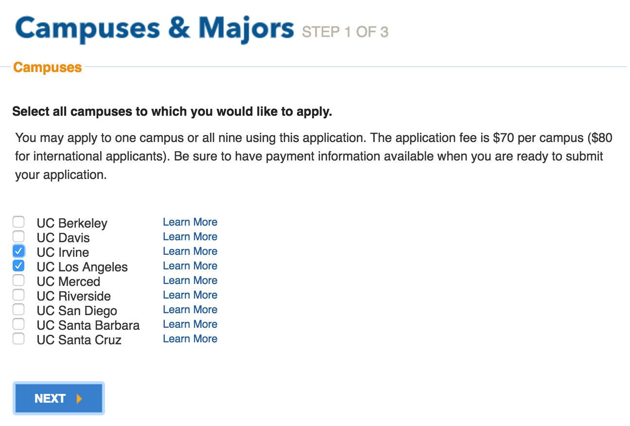
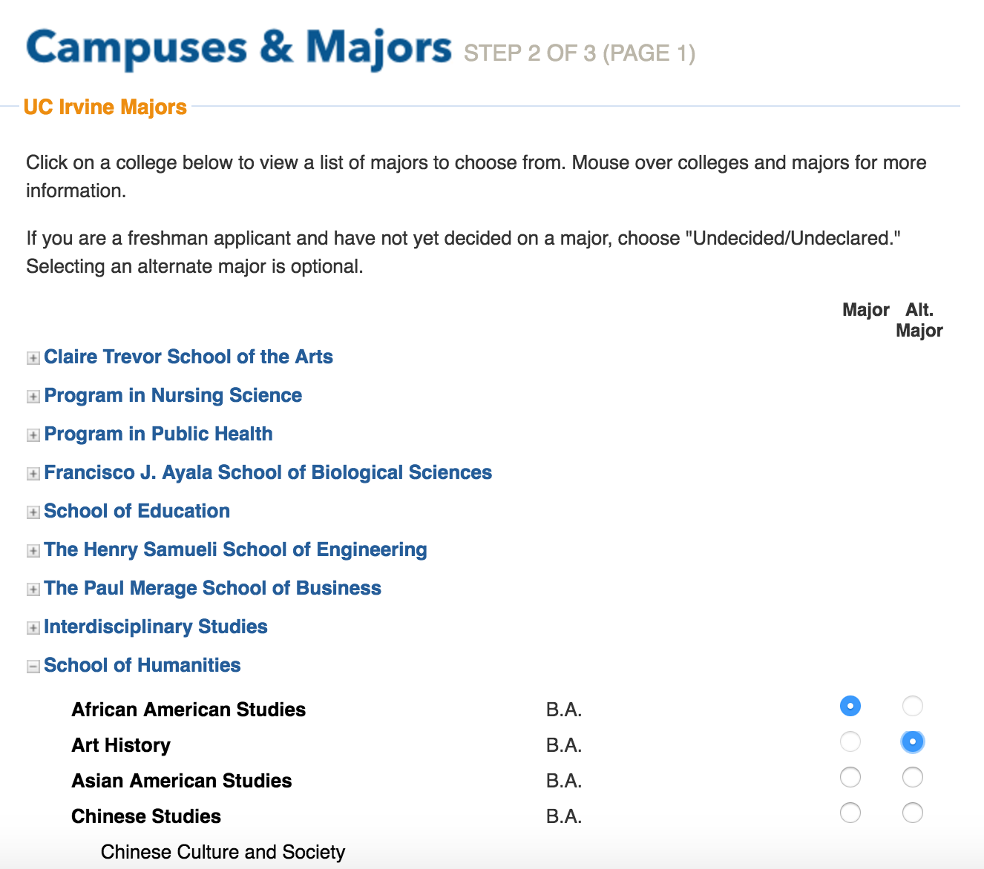
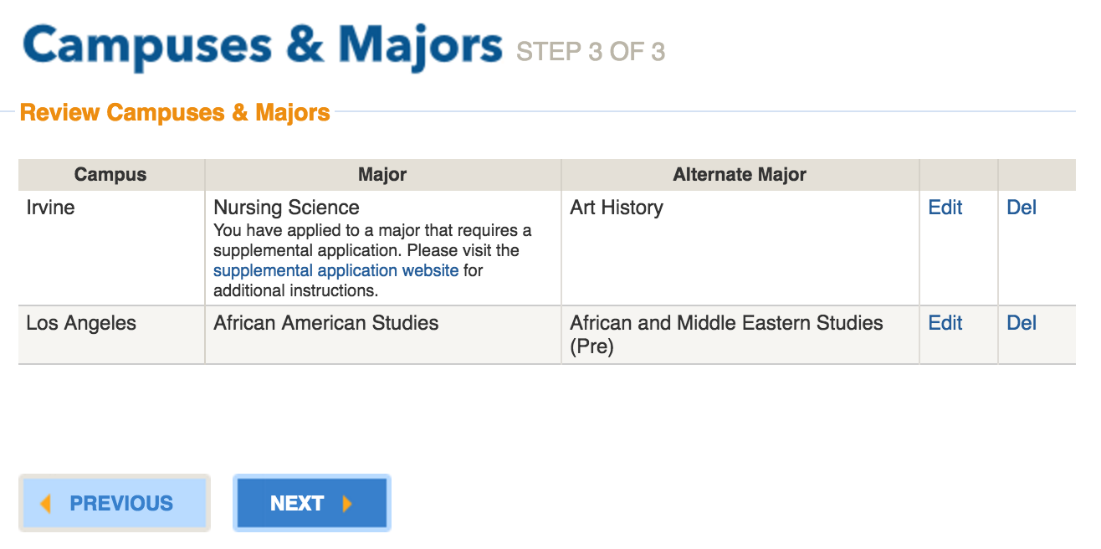
Campuses and Majors
Step 1: Select campus(es)
Step 2: Select major and alternate major
(if needed)
Step 3: Verify all information is correct

Slide 39
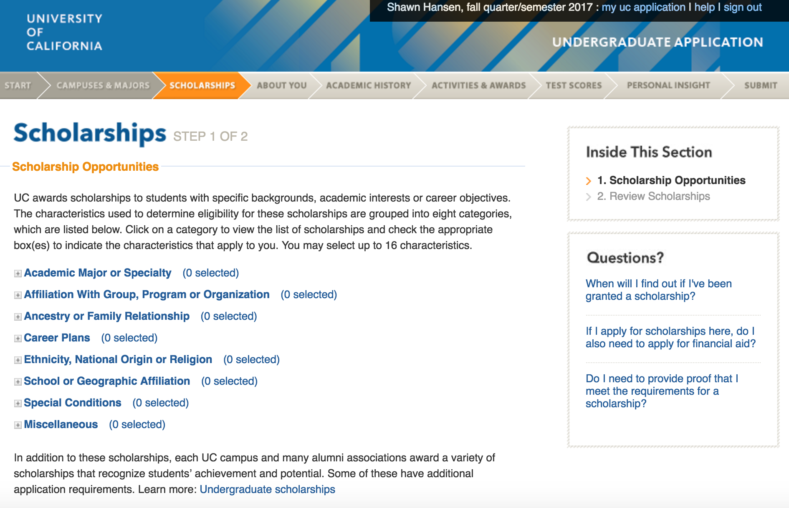
Scholarships

Slide 40
About You

Slide 41
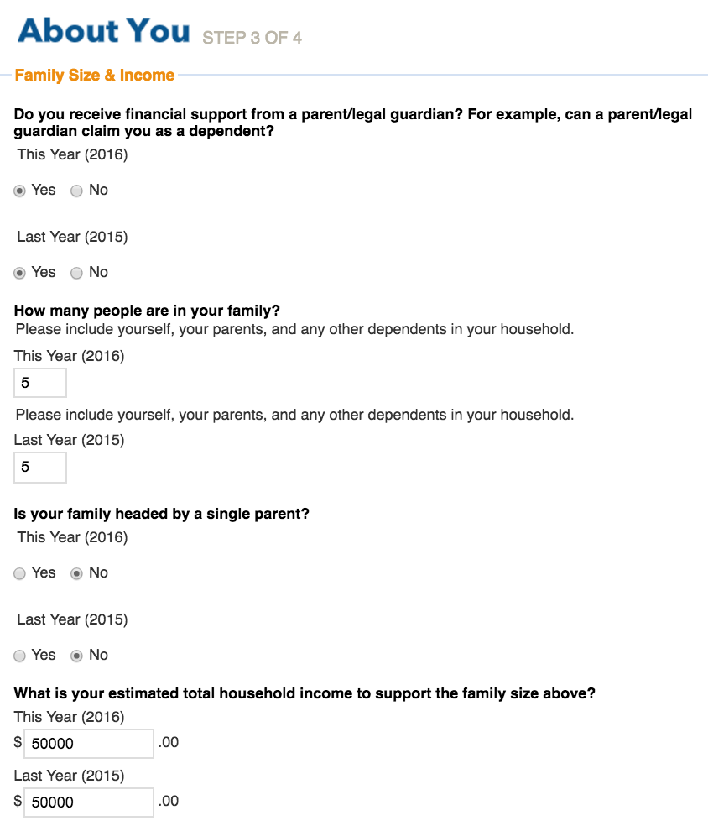

Slide 42
Academic History
If you took a Math or Language Other Than English in 7th or 8th grade and earned a "C" or higher, enter the grade earned here.

Slide 43
Step 2:
Enter CHS
School Code: 050700
050700
COVINA HIGH SCHOOL

Slide 44
Step 2:
Dates: Aug 2014- June 2018
Select: High/Secondary School Diploma, June 2018
Grading System: A B C D F
Term System: Semester

Slide 45
Enter your course work from grades 9-12. From grades 9-11 report all grades earned.
12th grade grades are reported as:
IP (In Progress)
PL (Plan to Learn)
or NP (Not Planned)

Slide 46
Activities & Awards
After entering your Activities & Awards be sure review before moving on.

Slide 47
Test Scores
Enter the test(s) you have taken.
Check the Not Received box if you are taking the ACT/SAT in the months of Nov. and/or Dec.

Slide 48
Personal Insight

Slide 50
Review Your Application

